Slide 1
2021. 06. 08
Deep Unsupervised Learning using Nonequilibrium Thermodynamics
4/24 DIYA CV
김재영

Slide 2
Contents
1. Abstract
2. Overview
3. Forward & Reversal Trajectory
4. Model probability & Training
5. Experiments

Slide 3
Abstract
propose new model inspired by nonequilibrium thermodynamics
- diffusion model
- destroy and restore structure in data distribution
- Ideas from physics, AIS(annealed importance sampling)
rather than variational Bayesian method.

Slide 4
Abstract
Tractability-Flexibility trade-off
- tractability – easy to analytical evaluate, fit to data.
- flexibility – can fit in arbitrary data.
Easy to evaluate model analytically.
- use AIS(annealed importance sampling
Multiplication with other distribution,
rapid learning, exact sampling,
getting lower and upper bound of entropy production…

Slide 5
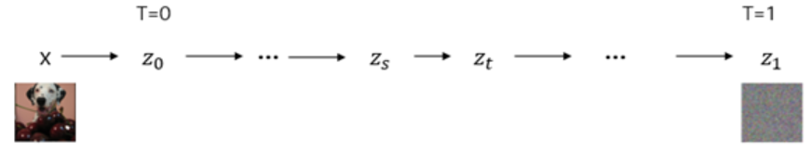
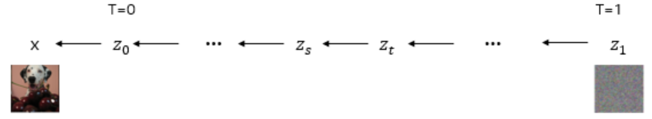
Overview
Model consists of two steps.
- forward trajectory, reversal trajectory
Forward trajectory. Slowly destroy structure of given data distribution.
Reversal trajectory. Restore structure of data distribution.
Each step uses Markov chain to gradually convert one distribution into another.

Slide 6
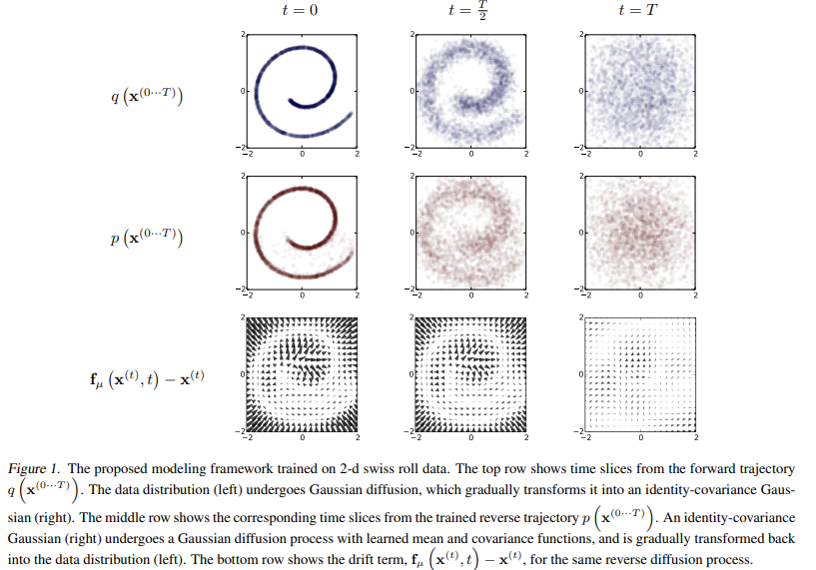
Overview
Forward trajectory
Reversal trajectory

Slide 7
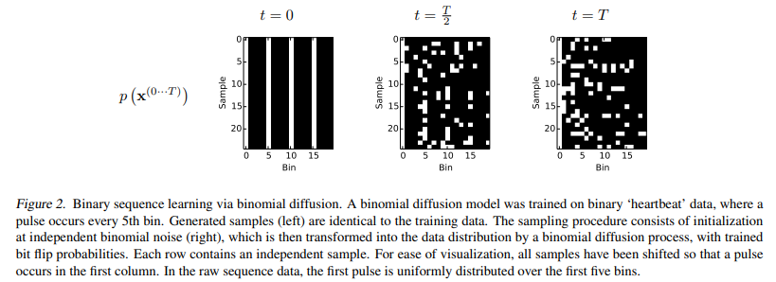
Overview

Slide 8
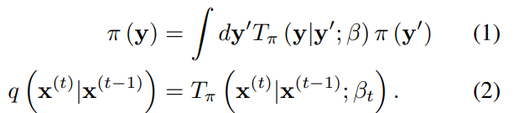
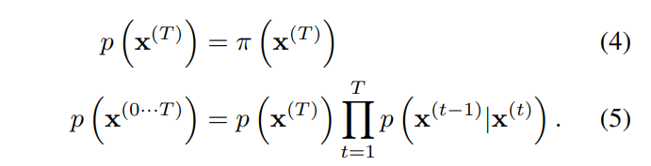

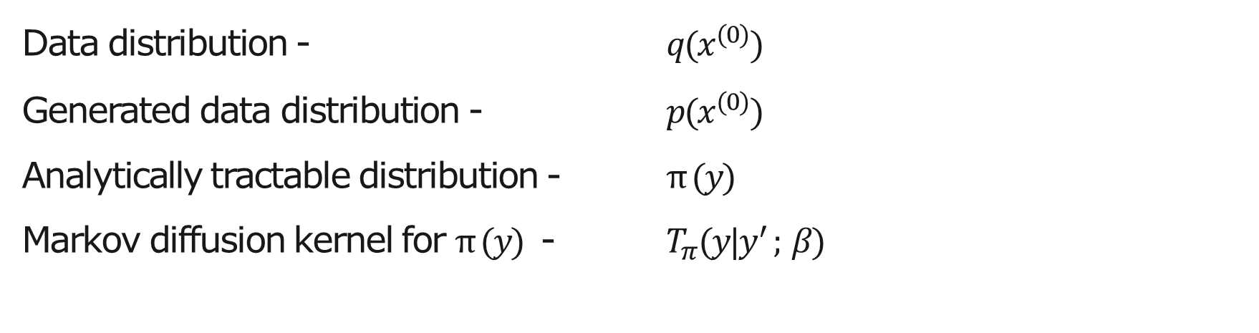
Forward & Reversal trajectory
Data distribution - ${q(x}^{(0)})$
Generated data distribution - ${p(x}^{(0)})$
Analytically tractable distribution - $π (y)$
Markov diffusion kernel for $π (y)$ - $T_{π}(y|y^{′} ; β)$
If $β$is small, reversal diffusion has identical function form as the forward diffusion one. (Feller, 1949)
Notes:
Langevin dynamics(1908) fokker-planck equation

Slide 9
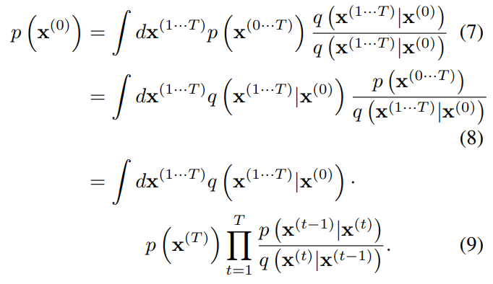
Model probability & Training
Probability of generative model assigned to data.

Slide 10
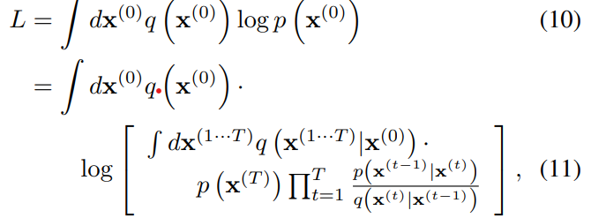
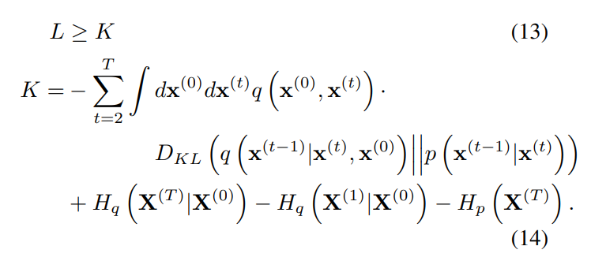
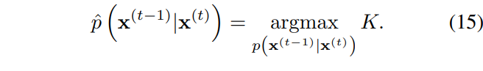
Model probability & Training
Training corresponds to maximizing log-likelihood L.
Log-likelihood L
Maximizing log-likelihood lower bound K.

Slide 11
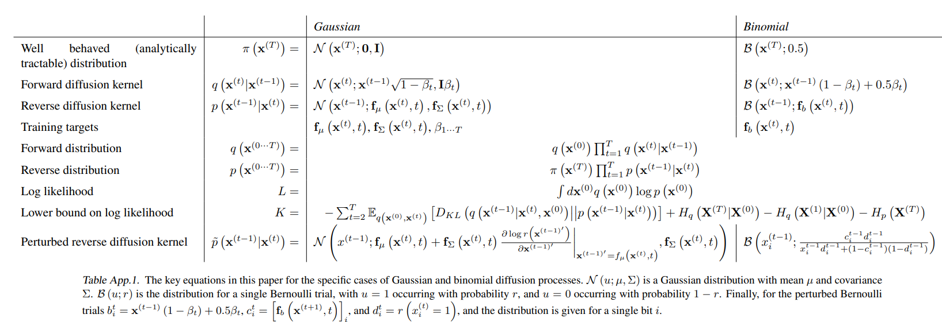
Model probability & Training

Slide 12
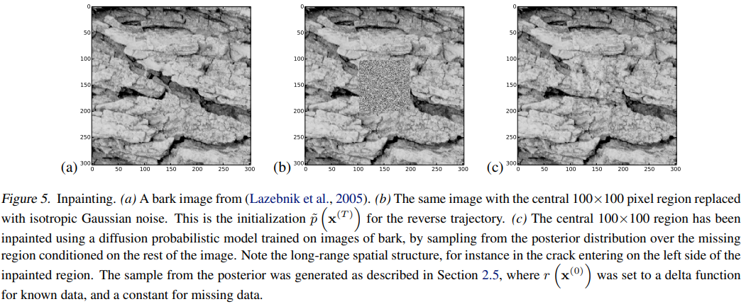
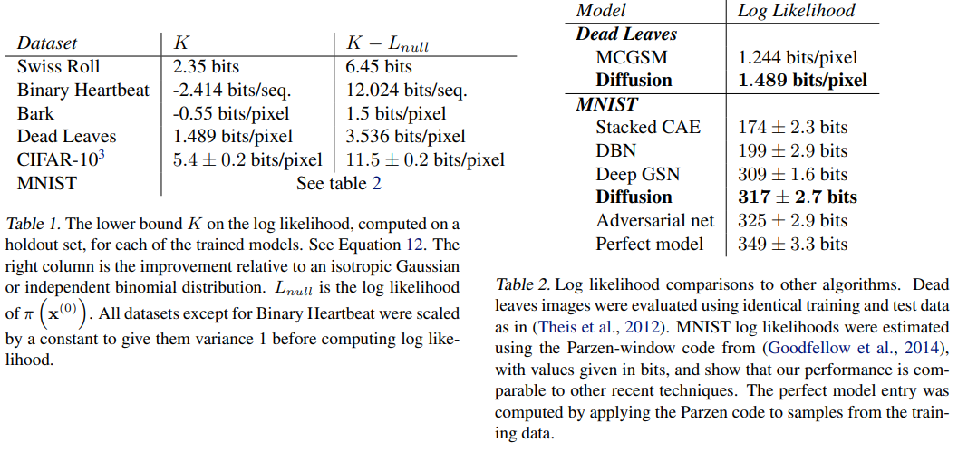
Experiments
Inference of missing value
Loglikelihood of experiment datasets

